Slide 1

RECOGNIZING OF MNIST IMAGE DATA HANDWRITTEN ALPHABETS

Slide 2
Agenda
• Problem Statement
• Data Description
• Project Life Cycle
• Understanding the data
• Data-Preprocessing
• Visualization
• Building the Models
/Streamlit/flask application for testing new image
• Conclusions
• Challenges

Slide 3
Problem Statement
Recognizing the Handwritten Image Alphabets of MNIST data by using the ML Algorithms.
Showing some nice analysis on the given data.
Showing the comparison of various ML models.
Took new image data for the predicting handwritten letters using best ML Algorithms

Slide 4
Dataset Description
1. MNIST Data is the handwritten Alphabets(images) that are commonly used for the training various image preprocessing.
2. These dataset consist of 3,72,451 handwritten images with the width and height of 28x28.
3. Image data is used for training and testing the data using the Algorithms.
4. These Image data is used for the predicting handwritten letters using the various ML Algorithms.

Slide 5
Exploratory Data Analysis
Dataset provide to us is image dataset process:
1. First unzipping the data in the google colab .
2. Reading the unzip files and using PIL library .
3. Checking the Properties of the images .
4. Resizing the Images using thumbnail in PIL library.

Slide 6
Data preprocessing
1. Converting to the NumPy array and converting to the 1D array using ravel().
2. Finally Converting it in to the data frame and uploaded into the drive.
3. Checking the Properties and some visualizations on the image data.

Slide 7
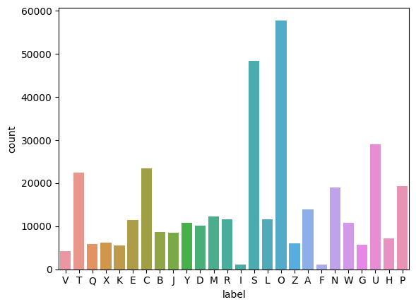
Data visualization
From graph we can observe that there is lot of imbalance data present in the given data

Slide 8
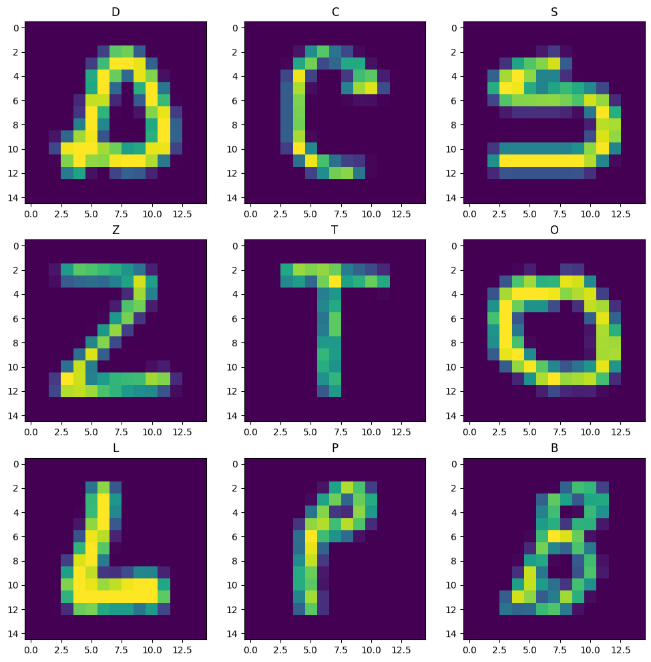
visualization
Printing random images with their
labels

Slide 9
Data Pre-Processing
Data pre-processing is the second step of the project life cycle on image data. It involves cleaning, formatting, and transforming the data for analysis.
1. Separating the Input and Output Variables.
2. Preparation of the Train and Test data with the train size of 75:25 split.
3. Building the model using the Classification Algorithms.

Slide 10
Building the Model Using Machine Learning Algorithms
Random Forest Classifier
Decision Tree Classifier
Logistic Regression

Slide 11
Building the Model Using Machine Learning Algorithms
1.Trained the data using the ALGORITHM by passing the X_Train and y_train to it and it will Build the Model.
2. Predicting the Handwritten Images by Passing the to the Generated Model and it will Predict the image.
3. By using Evaluation metrics for the Classification generated the accuracy score for it.

Slide 12
Conclusions
The results of the evaluation using accuracy score as the metric show that
RandomForestClassifier, Performing well compared to other models, with a score of 98.67%
DecisionTreeClassifier is the second-best performance, with a score 95.31%
However further evaluation and validation is necessary to confirm this conclusion.

Slide 13
Challenges
We faced many time ram issues due to the large amount of the data Regrading the image size initially they are 28x28 these is the large amount of data so It has taken the while converting into NumPy array and making the data frame.
While running the algorithm we faced some issues related to the time and some of the algorithms takes to much time like KNN and other algorithms.

Slide 14
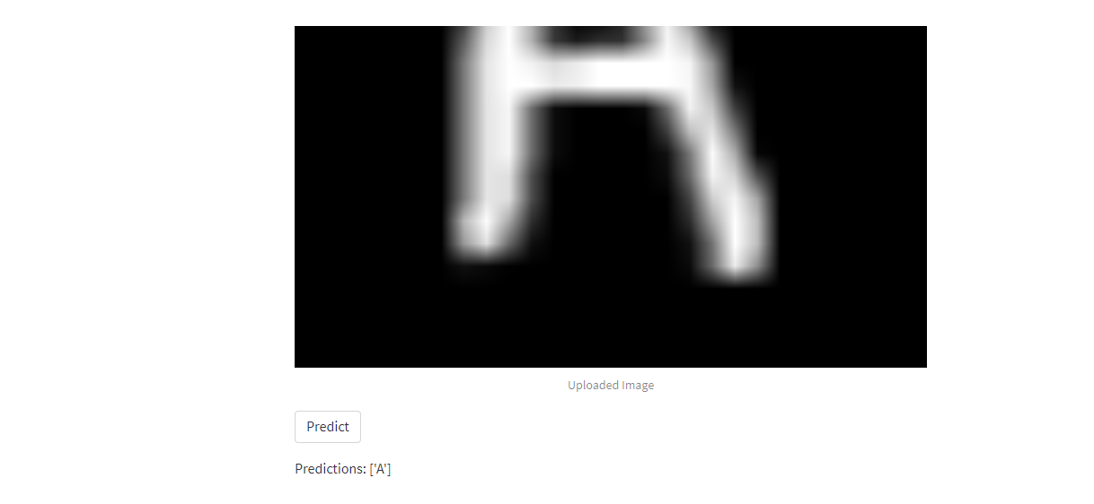
Streamlit application/predicting/ new alphabet

Slide 15
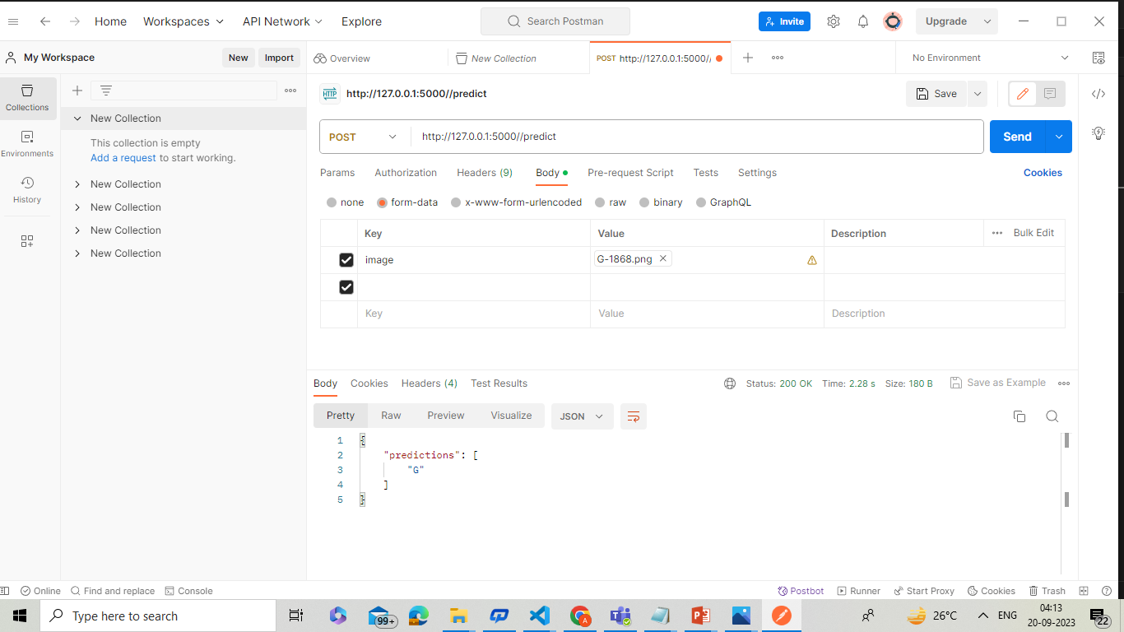
Rest api application for testing new image

Slide 16


Slide 17

THANK YOU

